Slide 1


Store Sales Analysis
Tarek Omar
Yassin Ahmed
Retaj Yasser
Eman Abdelrahim

Slide 2

Project Idea
Brief Description of the Problem Being Solved
Sales data contains orders, customers, products, and regions—but extracting insights is challenging:
Identify trends: Top-performing categories and seasonal patterns
Understand performance: Customer segments and regional variations
Optimize decisions: Inventory, marketing, and resource allocation
2. Overview of the Proposed Solution
A data-driven dashboard will be developed to:
📊Visualize Key Metrics: Sales, profits, and customer behavior.
📈Analyze Trends: Time-based patterns, product performance, and regional comparisons.
3. Unique value proposition
🔹 Interactive Insights: Dynamic filters (region/category/time period)
🔹 User-Friendly Design: Intuitive for all stakeholders.

Slide 3
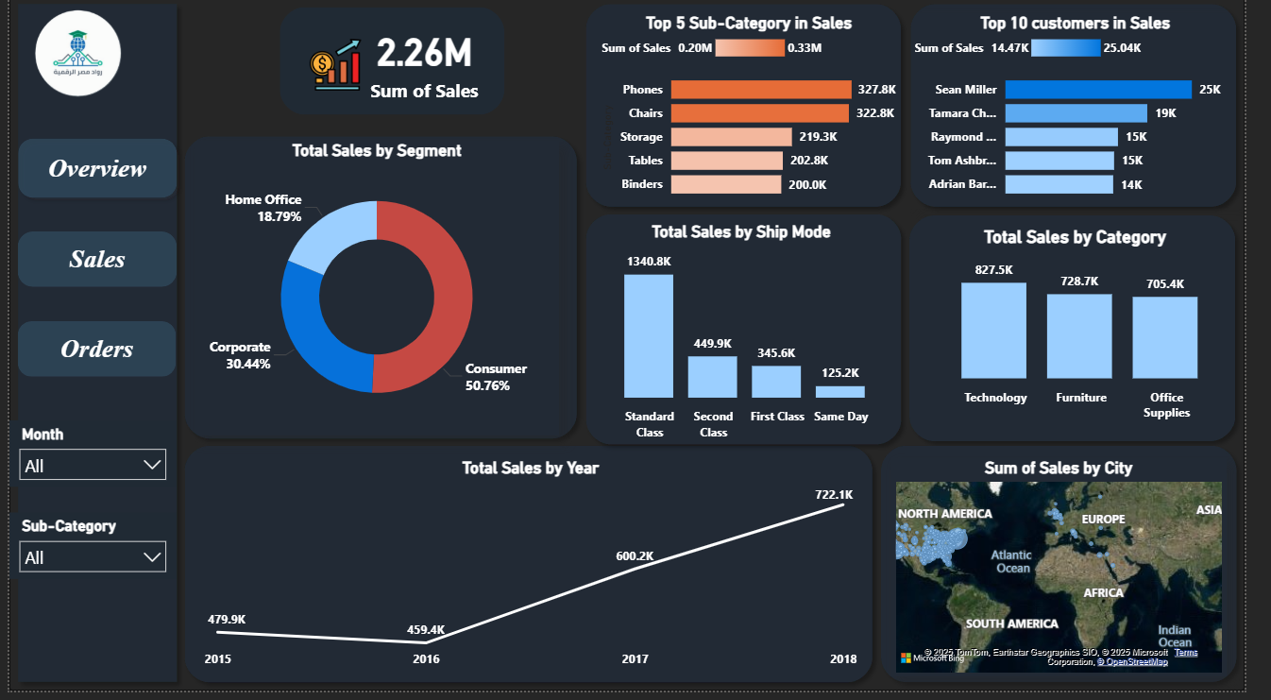
Project Wireframe
4
Selected page
2) Filter by Month/category with dropdowns
3) Visual trend analysis helps
predict seasonality
4) Main KPI
1
2
3

Slide 4
End Users + Features
End Users (Primary Personas):
📈Sales Managers: Monitor performance, detect trends, and set targets
📊Business Owners: Make data-driven decisions to increase revenue
🔎Data Analysts: Extract insights , visualize KPIs, and report findings
Key Features:
Interactive Dashboards – Visualize sales trends, top products, and regions
Real-time Sales Tracking – Monitor live performance and inventory movement
Predictive Analytics – Forecast future sales and demand
How the Features Meet User Needs:
Interactive dashboards allow sales managers to monitor key performance indicators in real-time
For data analysts, automated reporting tools save time and reduce errors by eliminating the need for manual data processing

Slide 5
Data Structure
Database Architecture
Source : XLS file (9801 record x 18 columns)
Type : Relational
Balanced Dataset : Well-distributed across categories and regions
Data Types : Mixed types
Techniques Used
Descriptive statistics for summarization.
Data cleaning (e.g., handling missing values).
Exploratory analysis for trends and relationships among features.

Slide 6

Programming Languages + Frameworks
Programming Languages
Python (Data processing, EDA)
SQL (Database queries)
DAX (Power BI metrics)
Tools
📊 Power BI (Dashboarding)

Slide 7
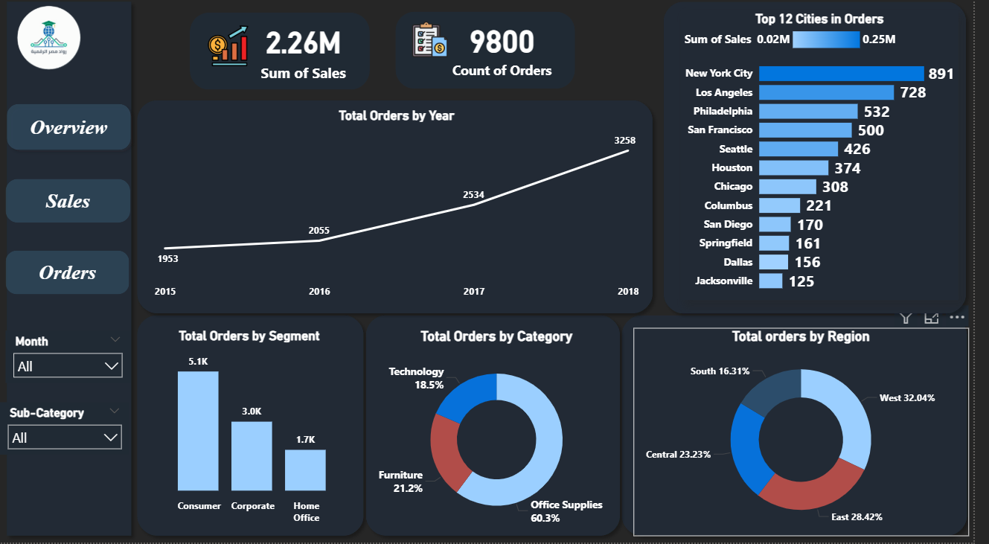
Live Application + Test
Current State
Status: Ready for deployment
Data Coverage
Sales: $2.26M total, tracked by month/sub-category/segment.
Orders: 9,800 total, analyzed by year/region/category.
Testing Performed
Unit Testing: Validated DAX measures
Integration Testing:
Slicers (Month/Sub-Category) updating all visuals.

Slide 8
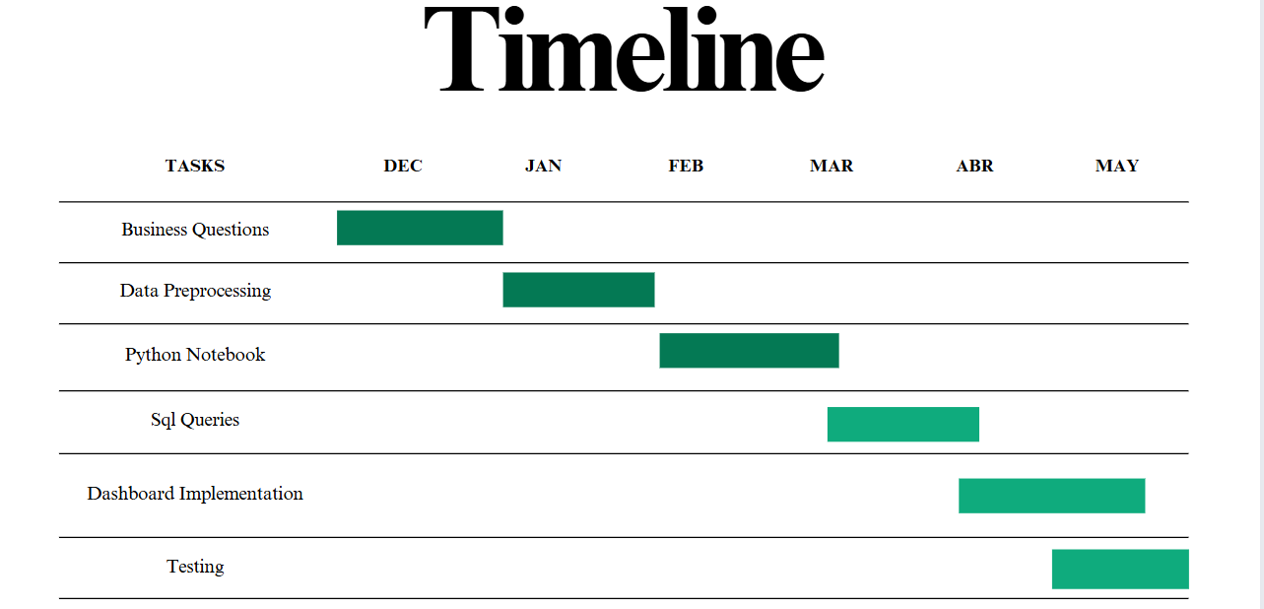
Project Deliverables
Python Notebook (Data cleaning and visualizations )
Sql Queries
Documentation
Presentation
Dashboard
Project Timeline

Slide 9

Project Team & Responsibilities
Tarek Omar : Python Notebook
Yassin Ahmed : SQL Queries
Retaj Yasser : Dashboard (Power BI)
Eman Abdelrahim: Preprocessing (Power BI)
Collaboration Methods
Weekly Meetings
Notion

Slide 10
Thank You

